Slide 1
Unit 21~22
The State and Strategy Patterns
Design Patterns
Notes:
Presentation
D3 - undergraduate

Slide 2
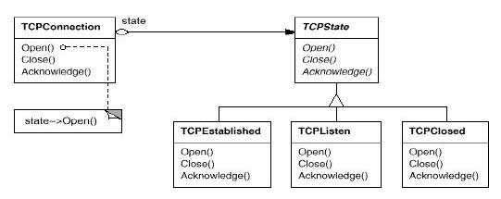
The State Pattern
Intent
  Allow an object to alter its behavior when its internal state changes. The object will appear to change its class.
  Motivation
Notes:
Scope – class is static, inheritance
Object - references

Slide 3
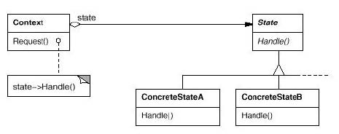
The State Pattern
Structure
Notes:
Less cluttered diagrams
Reminder

Slide 4
The State Pattern
Consequences
  Benefits
    Puts all behaviour associated with a state into one object
    Allows state transition logic to be incorporated into a state object rather than in a monolithic (整体) if or switch statement
    Helps avoid inconsistent states since state changes occur using just the one state object and not several objects or attributes
  Liabilities
    Increased number of objects
Notes:
OH with complete chart
Zimmer’s Gamma and Gamma’s Gamma not the same

Slide 5
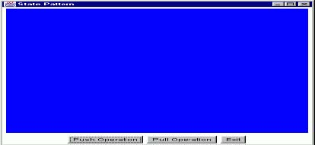
State Pattern Example 1
Consider a class that has two methods, push() and pull(), whose behavior changes depending on the state of the object
To send the push and pull requests to the object, we'll use the following GUI with "Push" and "Pull" buttons:
The state of the object will be indicated by the color of the canvas in the top part of the GUI
The states are: black, red, blue and green

Slide 6
State Pattern Example 1(Continued)
First, let's do this without the State pattern:
  /**
  *Class ContextNoSP has behavior dependent on its state.
  * The push() and pull() methods do different things
  * depending on the state of the object.
  * This class does NOT use the State pattern. */
  public class ContextNoSP {
    // The state!
    private Color state = null;
    // Creates a new ContextNoSP with the specified state (color).
    public ContextNoSP(Color color) {state = color;}
    // Creates a new ContextNoSP with the default state
    public ContextNoSP() {this(Color.red);
  }

Slide 7
State Pattern Example 1(Continued)
  // Returns the state.
  public Color getState() {return state;}
  // Sets the state.
  public void setState(Color state) {this.state = state;}
  /**
  *The push() method performs different actions depending
  * on the state of the object. Actually, right now
  * the only action is to make a state transition.
  */
  public void push() {
    if (state == Color.red) state = Color.blue;
    else if (state == Color.green) state = Color.black;
    else if (state == Color.black) state = Color.red;
    else if (state == Color.blue) state = Color.green;
}
Notes:
Combine last two slides

Slide 8
State Pattern Example 1(Continued)
    /**
    *The pull() method performs different actions depending
    * on the state of the object. Actually, right now
    * the only action is to make a state transition.
    */
    public void pull() {
      if (state == Color.red) state = Color.green;
      else if (state == Color.green) state = Color.blue;
      else if (state == Color.black) state = Color.green;
      else if (state == Color.blue) state = Color.red;
  }
}
Notes:
Uses, combine, similar
Strategy – flyweight: both stateless
OH with complete chart

Slide 9
State Pattern Example 1(Continued)
Here’s part of the GUI test program:
  /**
  * Test program for the ContextNoSP class
  * which does NOT use the State pattern.*/
  public class TestNoSP extends Frame implements ActionListener {
    // GUI attributes.
    private Button pushButton = new Button("Push Operation");
    private Button pullButton = new Button("Pull Operation");
    private Button exitButton = new Button("Exit");
    private Canvas canvas = new Canvas();
    // The Context.
    private ContextNoSP context = null;
Notes:
Zimmer’s idéa

Slide 10
State Pattern Example 1(Continued)
  public TestNoSP() {
    super("No State Pattern");
    context = new ContextNoSP();
    setupWindow();
  }
  private void setupWindow() { // Setup GUI }
  // Handle GUI actions.
  public void actionPerformed(ActionEvent event) {
  Object src = event.getSource();
  if (src == pushButton) context.push();
  canvas.setBackground(context.getState());
  }
Notes:
Very general
Used in a lot of other patterns
Applicability
Participants
Collaborations

Slide 11
State Pattern Example 1(Continued)
      else if (src == pullButton) {
        context.pull();
        canvas.setBackground(context.getState());
    }
    else if (src == exitButton) System.exit(0);
    }
  }
  // Main method.
  public static void main(String[] argv) {
  TestNoSP gui = new TestNoSP();
  gui.setVisible(true);
  }
}
Notes:
Better organization
Arrows form acyclig graph

Slide 12
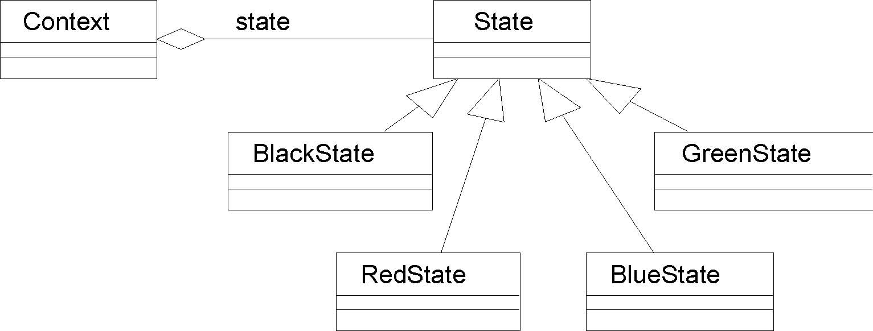
State Pattern Example 1(Continued)
Now let's use the State pattern!
Here's the class diagram:

Slide 13
State Pattern Example 1(Continued)
First, we'll define the abstract State class:
  /**
  * Abstract class which defines the interface for the
  * behavior of a particular state of the Context.
  */
  public abstract class State {
    public abstract void handlePush(Context c);
    public abstract void handlePull(Context c);
    public abstract Color getColor();
  }
Next, we'll write concrete State classes for all the different states: RedState, BlackState, BlueState and GreenState

Slide 14
State Pattern Example 1(Continued)
For example, here's the BlackState class:
  public class BlackState extends State {
    // Next state for the Black state:
    // On a push(), go to "red"
    // On a pull(), go to "green"
    public void handlePush(Context c) {
    c.setState(new RedState());
    }
    public void handlePull(Context c) {
    c.setState(new GreenState());
    }
    public Color getColor() {return (Color.black);}
  }

Slide 15
State Pattern Example 1(Continued)
And, here's the new Context class that uses the State pattern and the State classes:
  /**
  * Class Context has behavior dependent on its state.
  * This class uses the State pattern.
  * Now when we get a pull() or push() request, we
  * delegate the behavior to our contained state object!
  */
  public class Context {
    // The contained state.
    private State state = null; // State attribute
    // Creates a new Context with the specified state.
    public Context(State state) {this.state = state;}

Slide 16
State Pattern Example 1(Continued)
  // Creates a new Context with the default state.
  public Context() {this(new RedState());}
  // Returns the state.
  public State getState() {return state;}
  // Sets the state.
  public void setState(State state) {this.state = state;}

Slide 17
State Pattern Example 1(Continued)
  /**
  * The push() method performs different actions depending
  * on the state of the object. Using the State pattern,
  * we delegate this behavior to our contained state object.
  */
  public void push() {state.handlePush(this);}
  /**
  *The pull() method performs different actions depending
  * on the state of the object. Using the State pattern,
  * we delegate this behavior to our contained state object.
  */
  public void pull() {state.handlePull(this);}
}

Slide 18
The State Pattern
Implementation Issues
  Who defines the state transitions?
    The Context class => ok for simple situations
    The ConcreteState classes => generally more flexible, but causes implementation dependencies between the ConcreteState classes
    Example 1 has the ConcreteState classes define the state transitions
  When are the ConcreteState objects created?
    Create ConcreteState objects as needed
    Create all ConcreteState objects once and have the Context object keep references to them
    Example 1 creates them as needed
  Can't we just use a state-transition table for all this?
    Harder to understand
    Difficult to add other actions and behavior

Slide 19
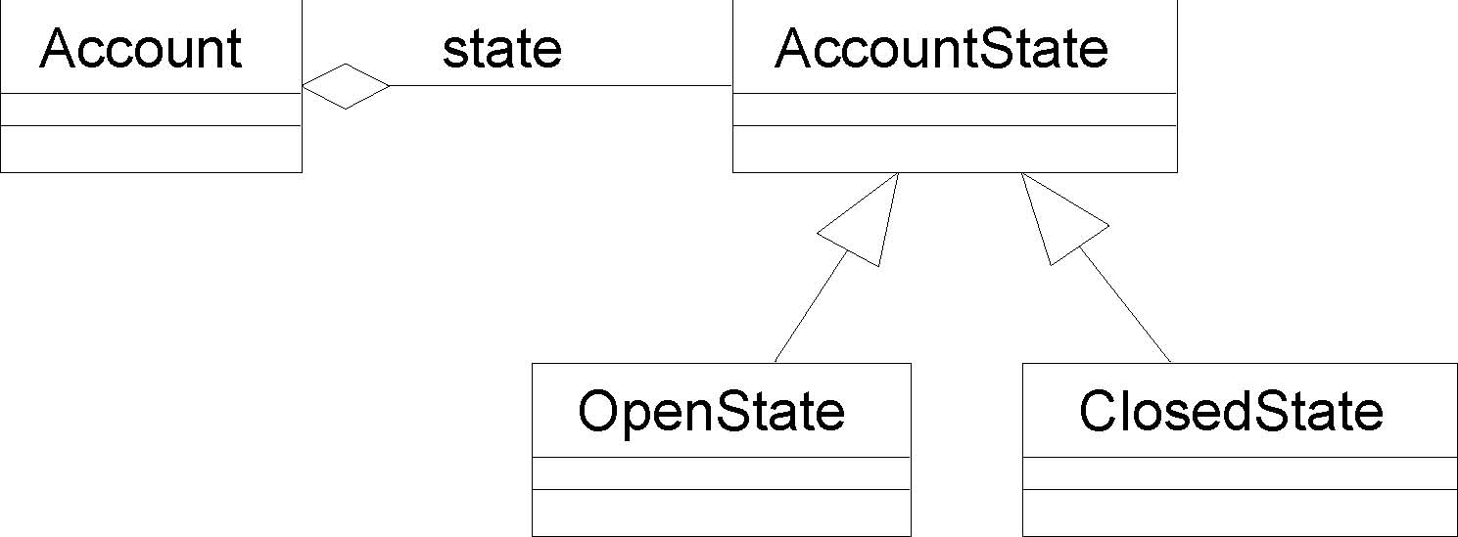
State Pattern Example 2
Situation: A bank account can change from an open account to a closed account and back to an open account again. The behavior of the two types of accounts is different.
Solution: Use the State pattern!

Slide 20
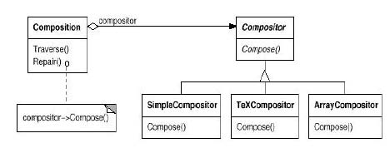
The Strategy Pattern
Intent
  Define a family of algorithms, encapsulate each one, and make them interchangeable. Strategy lets the algorithms vary independently from clients that use it.
Motivation

Slide 21
The Strategy Pattern
Applicability
Use the Strategy pattern whenever:
  Many related classes differ only in their behavior
  You need different variants of an algorithm
  An algorithm uses data that clients shouldn't know about. Use the Strategy pattern to avoid exposing complex, algorithm-specific data structures.
  A class defines many behaviors, and these appear as multiple conditional statements in its operations. Instead of many conditionals, move related conditional branches into their own Strategy class.

Slide 22
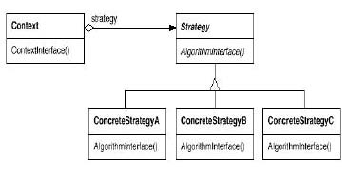
The Strategy Pattern
Structure

Slide 23
The Strategy Pattern
Consequences
  Benefits
    Provides an alternative (供选择的) to subclassing the Context class to get a variety of algorithms or behaviors
    Eliminates large conditional statements
    Provides a choice of implementations for the same behavior
  Liabilities
    Increases the number of objects
    All algorithms must use the same Strategy interface

Slide 24
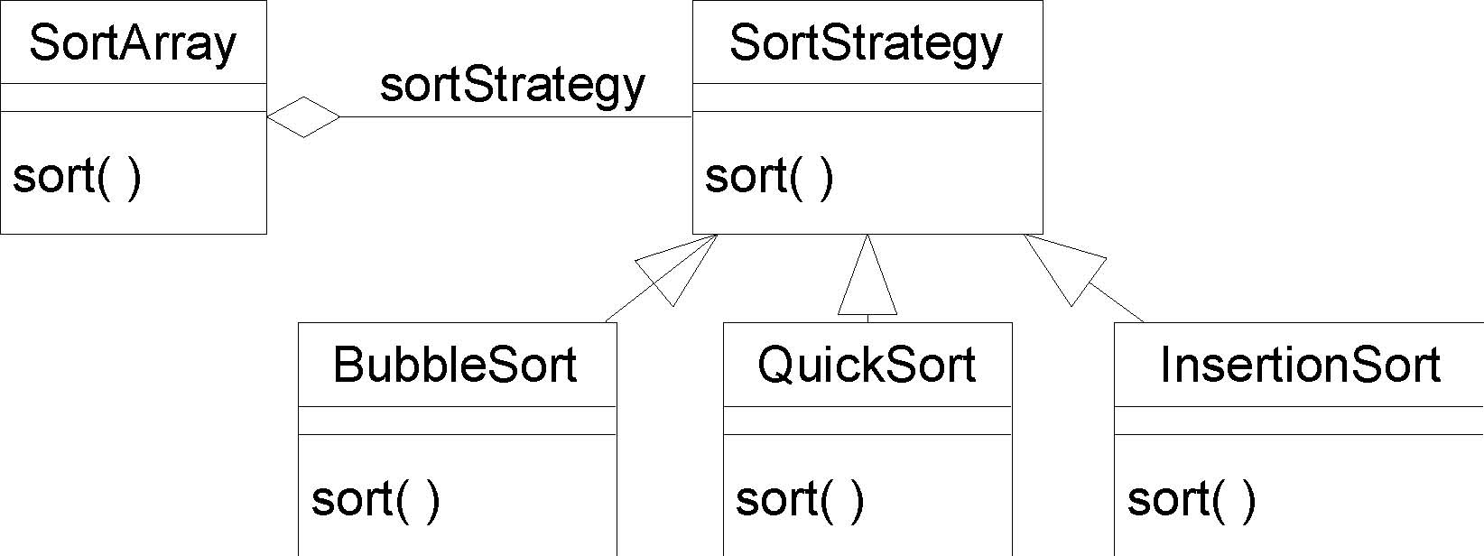
Strategy Pattern Example 1
Situation: A class wants to decide at run-time what algorithm it should use to sort an array. Many different sort algorithms are already available.
Solution: Encapsulate the different sort algorithms using the Strategy pattern!

Slide 25
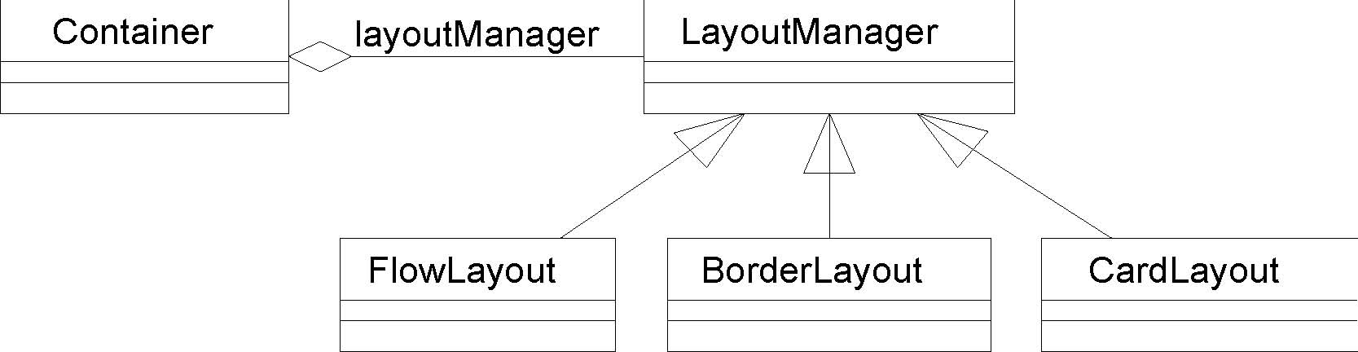
Strategy Pattern Example 2
Situation: A GUI container object wants to decide at run-time what strategy it should use to layout (布局) the GUI components it contains. Many different layout strategies are already available.
Solution: Encapsulate the different layout strategies using the Strategy pattern!
Hey! This is what the Java AWT does with its LayoutManagers!

Slide 26
Strategy Pattern Example 2(Continued)
Some client code:
  Frame f = new Frame();
  f.setLayout(new FlowLayout());
  f.add(new Button(“Press”));

Slide 27
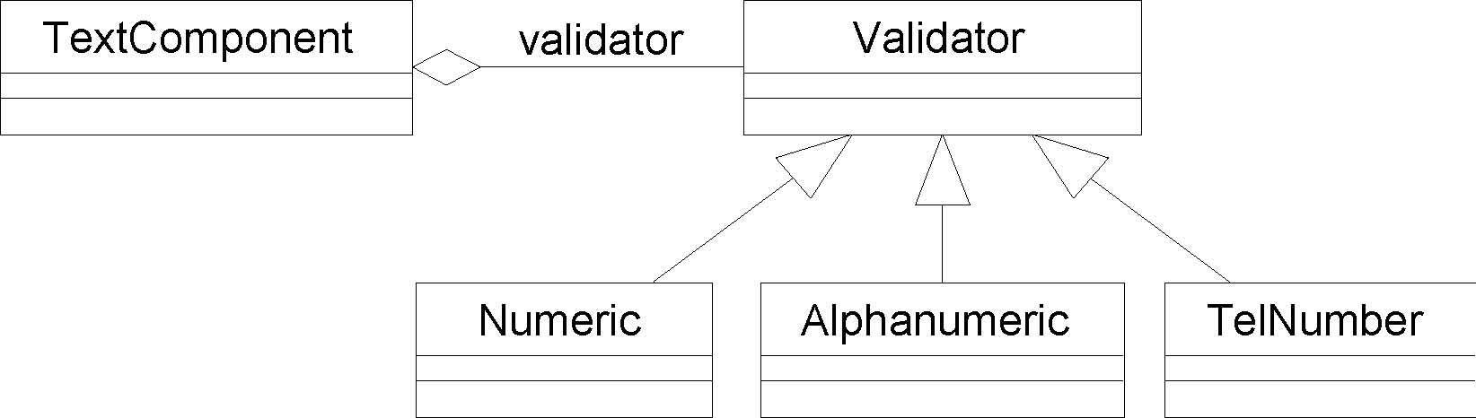
Strategy Pattern Example 3
Situation: A GUI text component object wants to decide at runtime what strategy it should use to validate user input. Many different validation strategies are possible: numeric fields, alphanumeric fields, telephone-number fields, etc.
Solution: Encapsulate the different input validation strategies using the Strategy pattern!

Slide 28
Strategy Pattern Example 3 (Continued)
This is the technique used by the Java Swing GUI text components. Every text component has a reference to a document model which provides the required user input validation strategy.

Slide 29
The Null Object Pattern
Sometimes the Context may not want to use the strategy provided by its contained Strategy object. That is, the Context wants a “donothing” strategy.
One way to do this is to have the Context assign a null reference to its contained Strategy object. In this case, the Context must always check for this null value:
  if (strategy != null)
  strategy.doOperation();

Slide 30
The Null Object Pattern
Another way to accomplish this is to actually have a “do-nothing” strategy class which implements all the required operations of a Strategy object, but these operations do nothing. Now clients do not have to distinguish between strategy objects which actually do something useful and those that do nothing.
Using a “do-nothing” object for this purpose is known as the Null Object Pattern

Slide 31
The Strategy Pattern
Note the similarities between the State and Strategy patterns! The difference is one of intent.
  A State object encapsulates a state-dependent behavior (and possibly state transitions)
  A Strategy object encapsulates an algorithm
And they are both examples of Composition with Delegation!

Slide 32
Summary
The State and Strategy Patterns

